Slide 1
Course Title: Programming Language I
Course Code: CSE110
Semester: Fall 2022

Slide 2
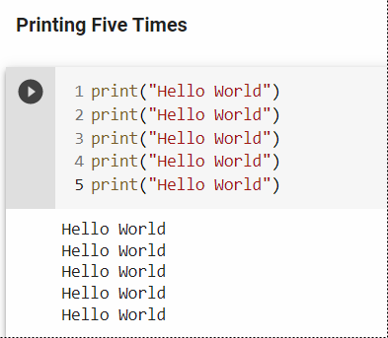
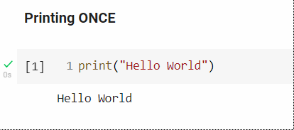
Introduction to Iterations

Slide 3
Introduction to Iterations
What will you do if it tells to print 100 times?
Should we copy paste the program 100 times?
What if it says to print 10,000 times?

Slide 4
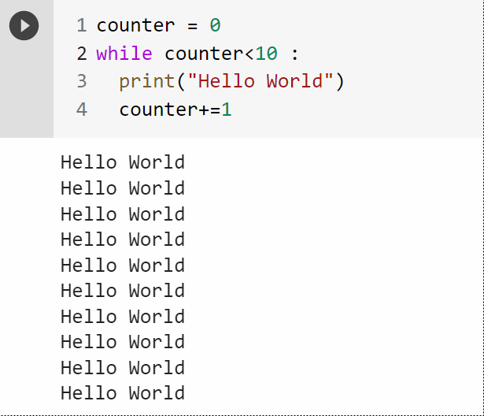
Python while loops
With the while loop we can execute a set of statements as long as a condition is true.

Slide 5
Components of while loop
Initial value/ value initialization
Condition
Block of Code
Increment/Decrement

Slide 6
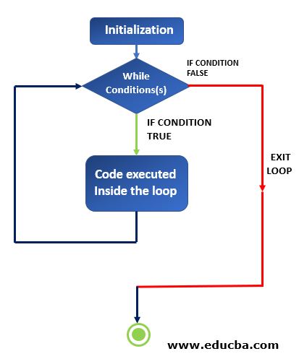
while loop

Slide 7
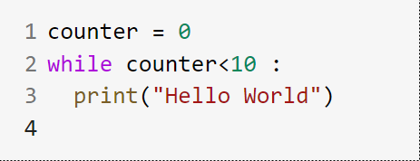
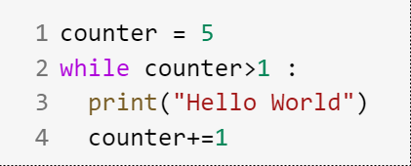
Infinite loop

Slide 8
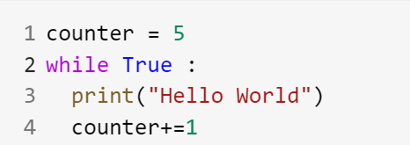
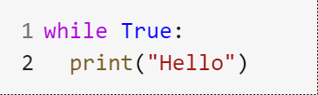
Infinite loop

Slide 9
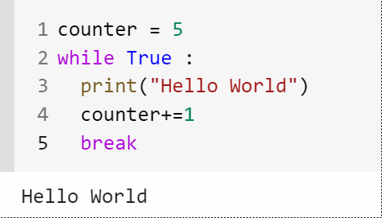
break Statement
It is a loop control statement
Suppose you want to terminate a loop and skip to the next code after the loop; break will help you do that.
It is used after the loop statements

Slide 10
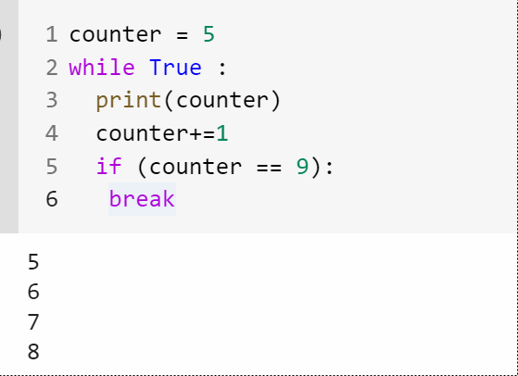
break Statement

Slide 11
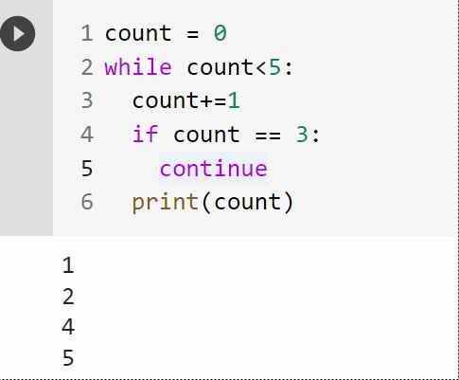
continue Statement
With the continue statement we can stop the current iteration, and continue with the next

Slide 12
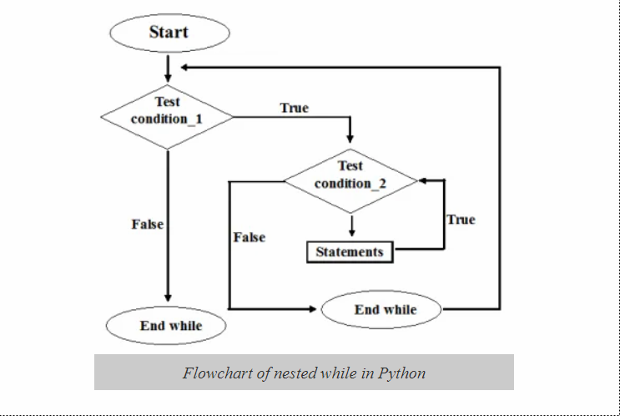
Nested while statement

Slide 13
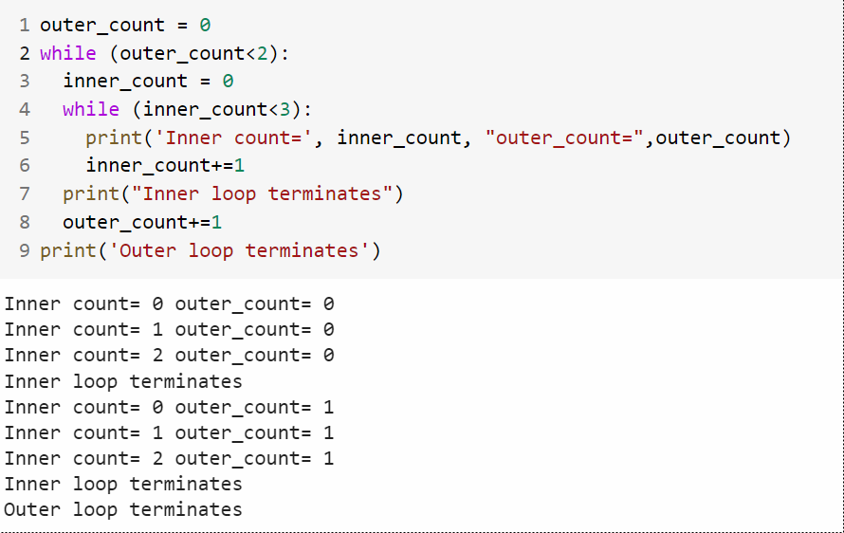
Nested while statement

Slide 14
Python range Function
The range() function returns a sequence of numbers, starting from 0 by default, and increments by 1 (by default), and stops before a specified number.
Syntax:
range(start, stop, step)

Slide 15
range Function Parameters
start: Optional. An integer number specifying at which position to start. Default is 0
stop: Required. An integer number specifying at which position to stop (not included).
step: Optional. An integer number specifying the incrementation. Default is 1

Slide 16
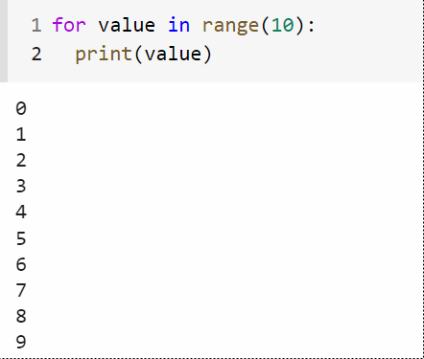
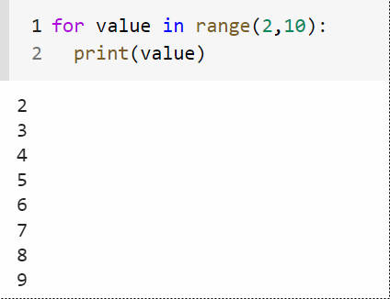
range Function Example

Slide 17
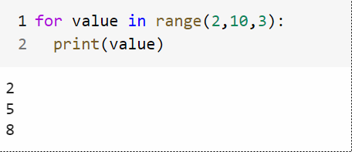
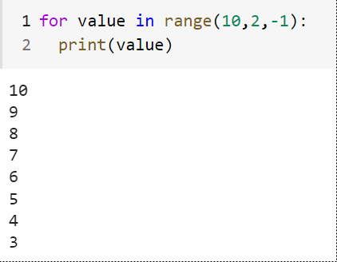
range Function Example

